Slide 1
ELECTRICAL ENGINEERING iii FPGA dEVELOPMENT PLATFORM
Ver. 2023/8/28
Quartus (Quartus Prime 20.1) Lite Edition

Slide 2
1. Download Quartus and add new project
2. Verilog coding, compile, simulate
3. Set device pin, download code to FPGA

Slide 3
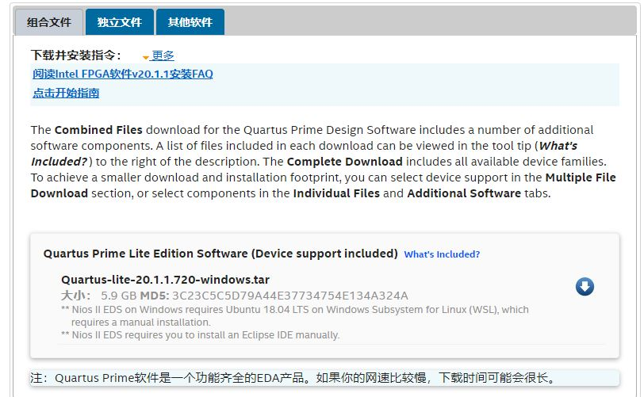
DOWNLOAD
FPGAs website (intel.com) download quartus 20.1 lite edition
Teaching website have Google Drive download link
※Need intel account

Slide 4
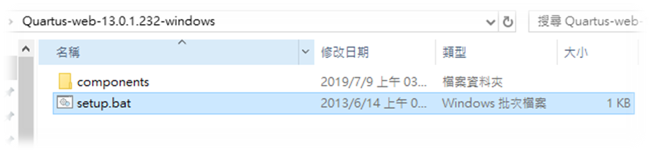
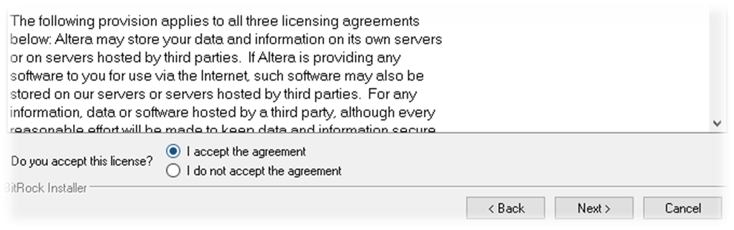
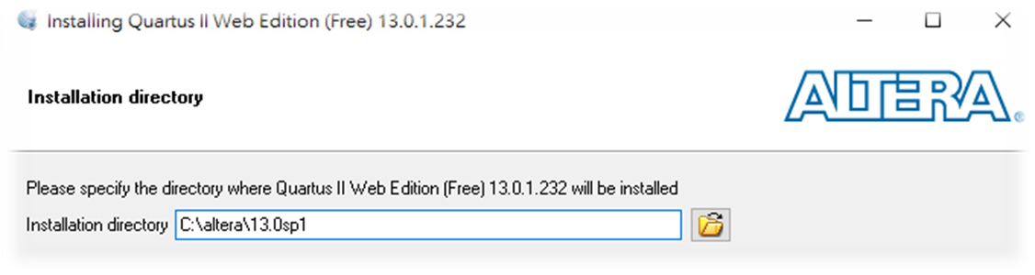
Setup
Download and extract file，open「setup.bat」file.
Accept the agreement.
Choose the installation directory
The installation path cannot contain
Chinese characters.

Slide 5
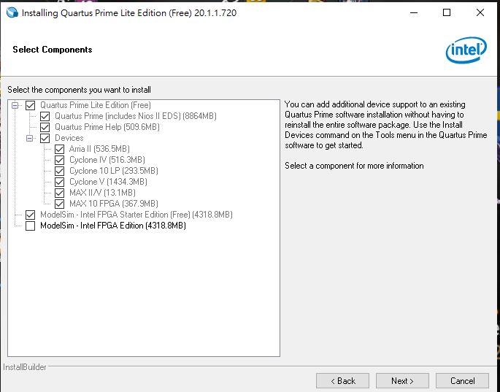
setup
Select the componets like picture.

Slide 6
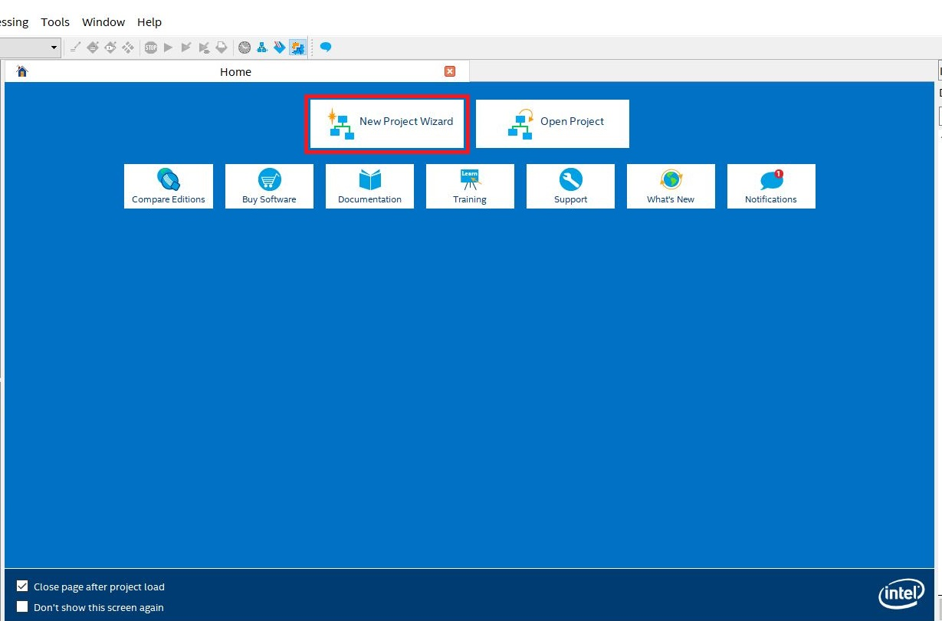
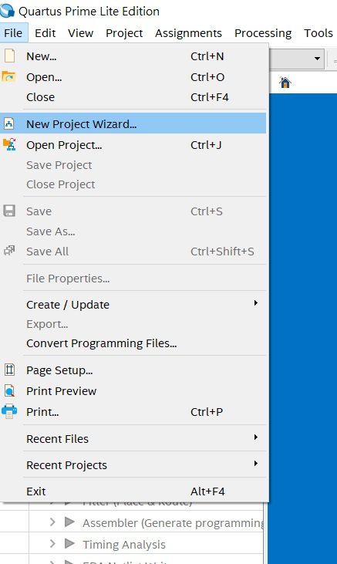
Create new project
Every implementation need create a new folder belong to the project
Create project
OR

Slide 7
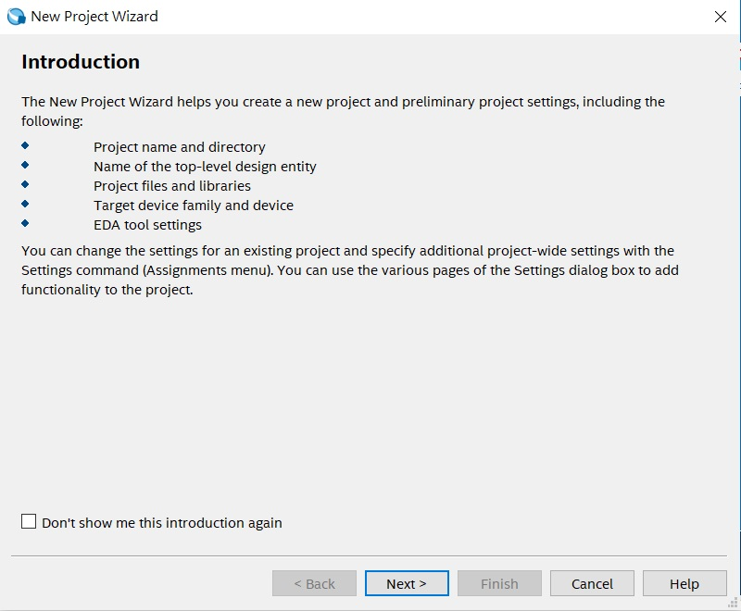
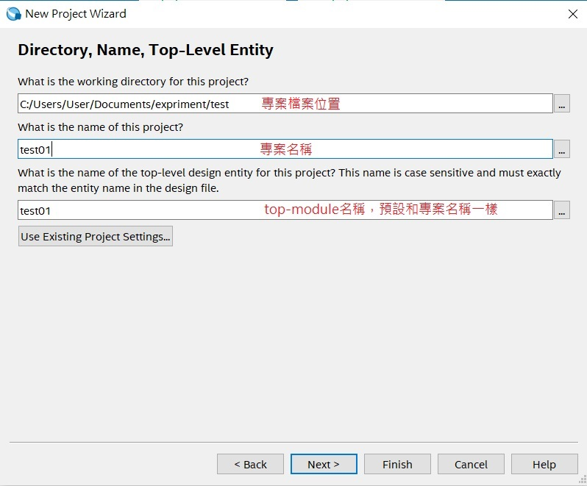
CREATE NEW PROJECT
Project derectory
Project name
Top-module name, as same as project name

Slide 8
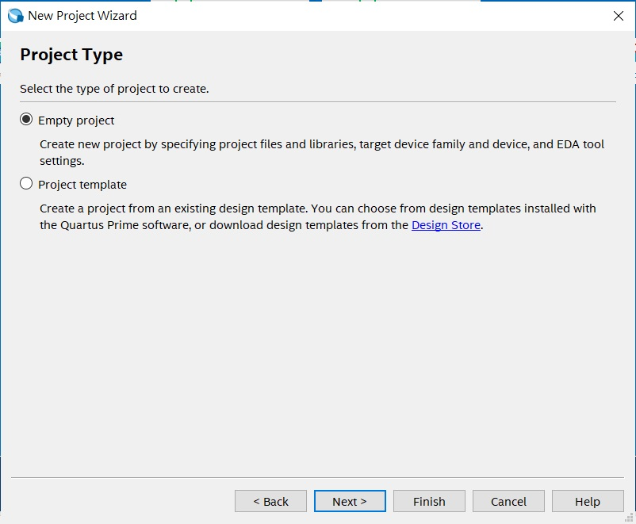
CREATE NEW PROJECT
Choose empty

Slide 9
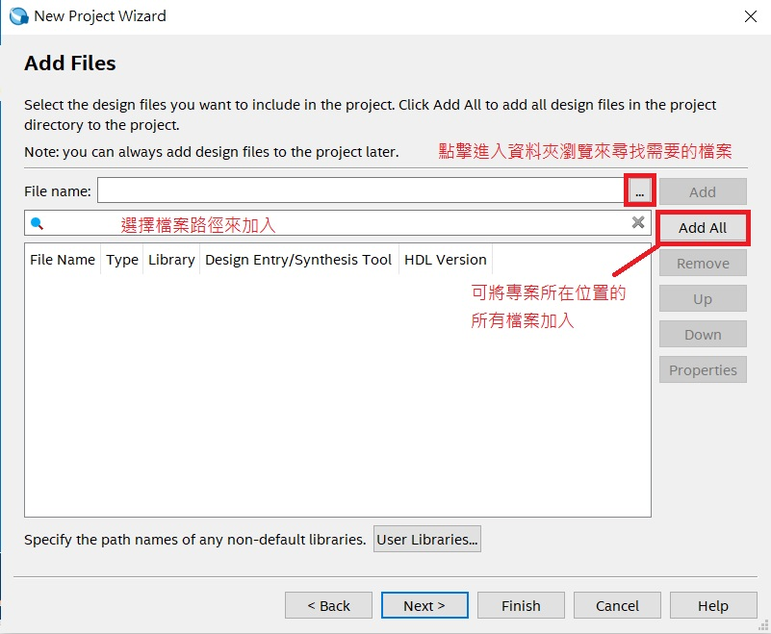
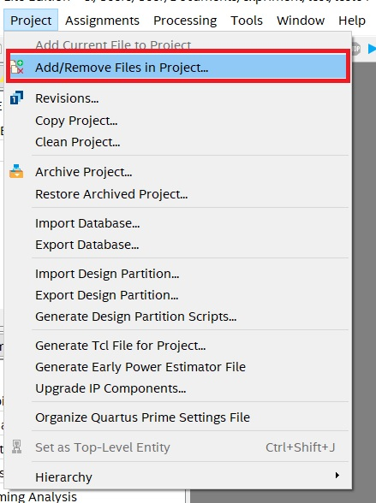
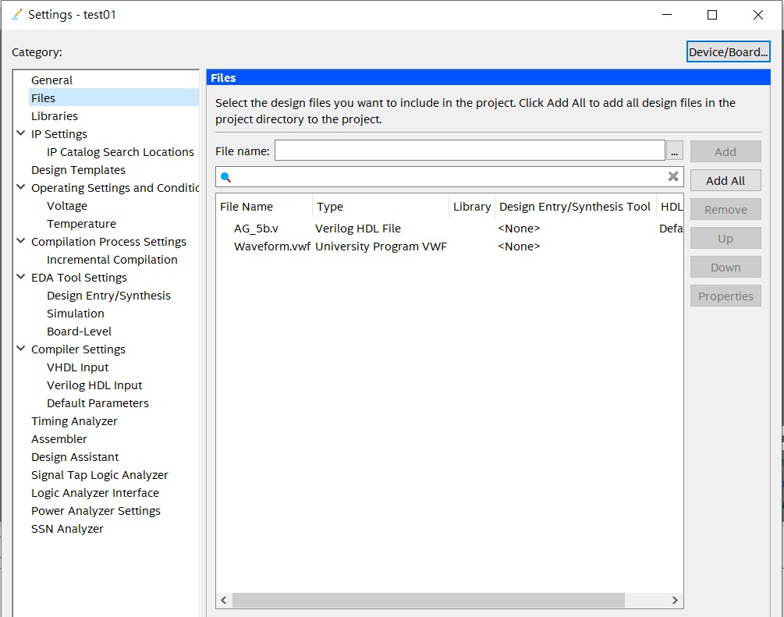
Load in files
Method 1:Before create Method 2:After create
Browse files
Add all files

Slide 10
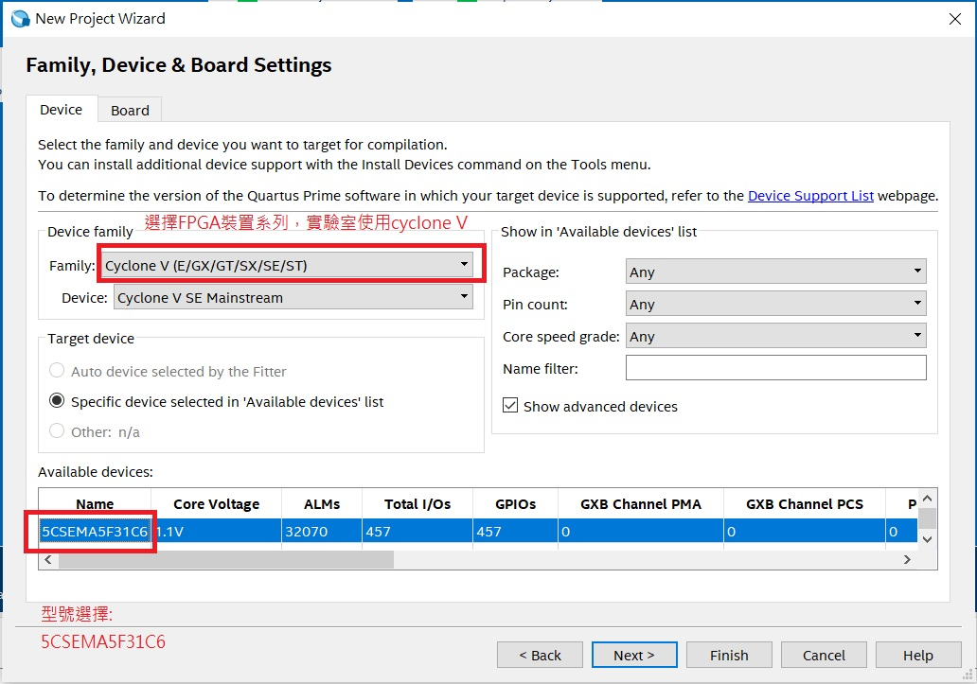
CREATE PROJECT
FPGA setting
Family: Cyclone V
Device: Cyclone V SE Mainstream
”Available devices”
Choose:”5CSEMA5F31C6”
5CSEMA5F31C6

Slide 11
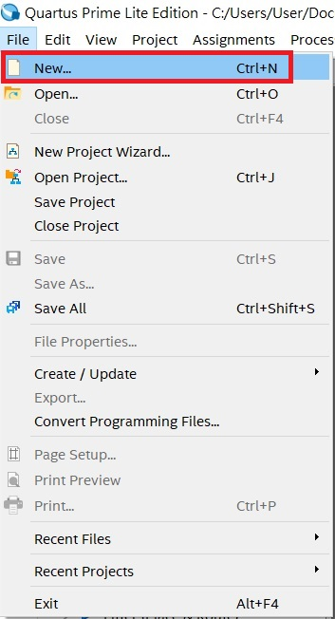
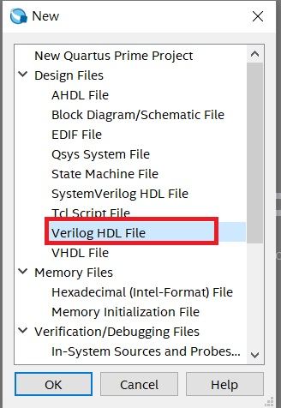
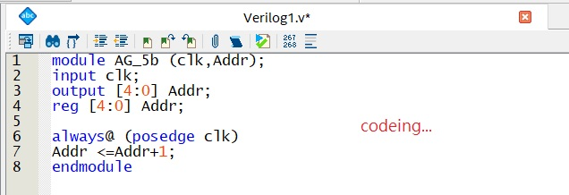
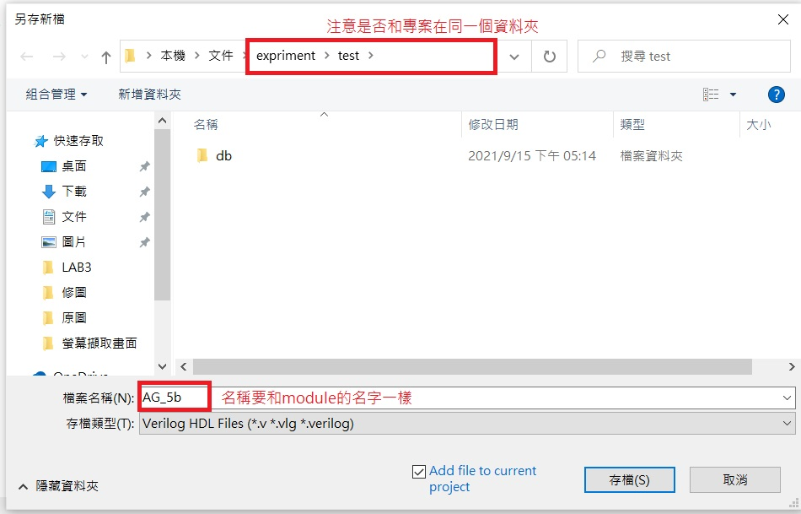
coding
New Verilog HDL File, save module after coding.
The file name should match the module project name. Otherwise, compilation will result in an error.
Verilog code
Add all files

Slide 12
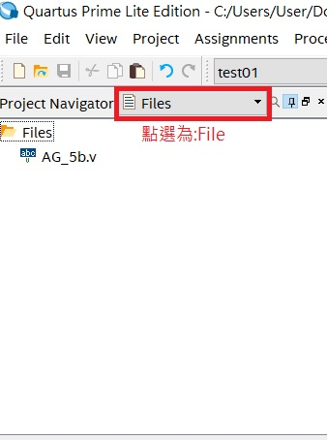

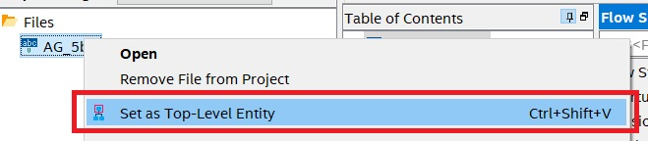
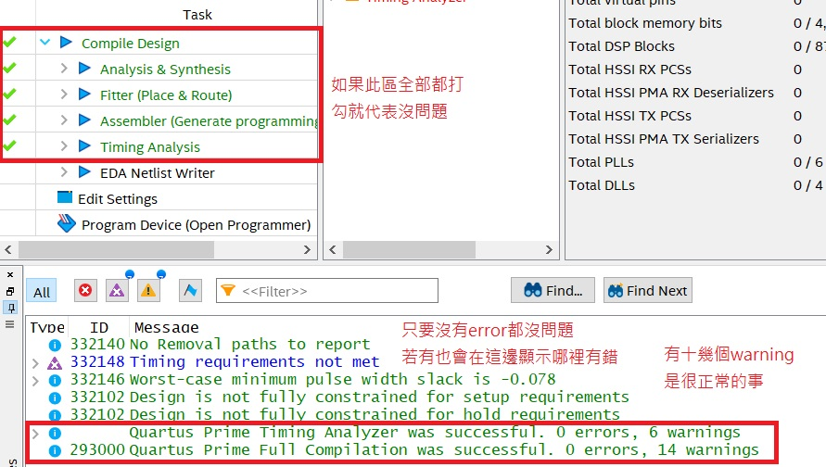
coding
Set the module as top-level module.
Press compile. If there are no error message, the compile is successful. Having warning message is normal.
compile
Right click
Choose files
No errors
Warning is normal

Slide 13
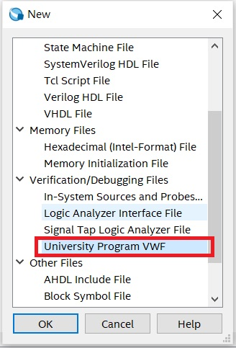
Waveform simulation
New「University Program VWF」file
※Remember set as Top-module before simulation

Slide 14
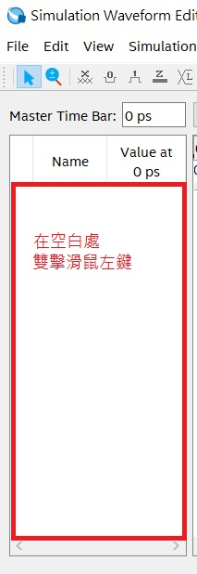
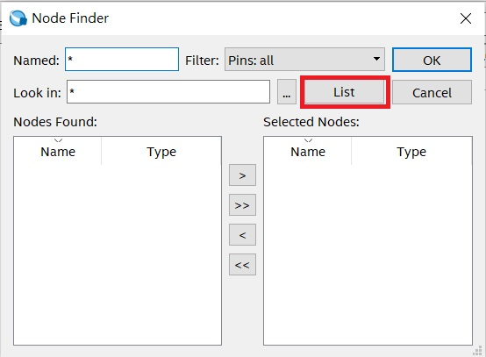
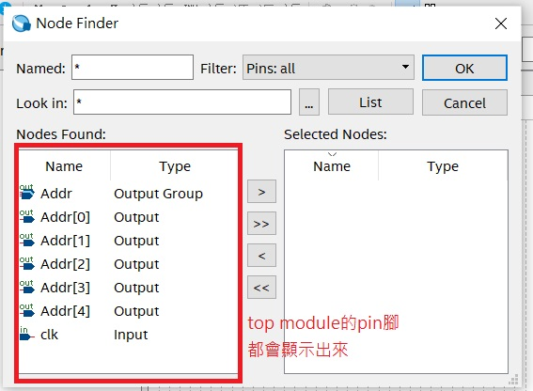
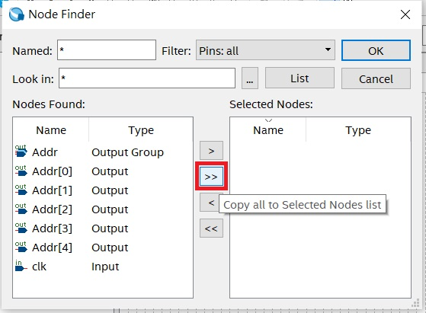
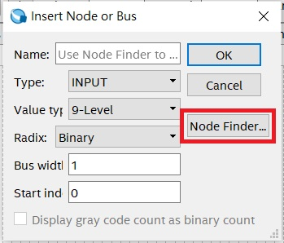
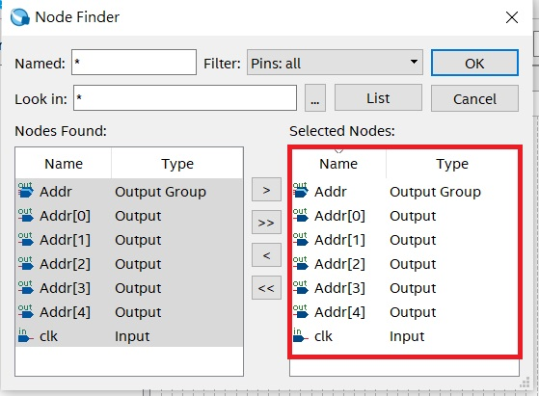
WAVEFORM SIMULATION
Add test I/O
Double clicks empty space, choose「Node Finder」.
Make sure filter field are "Pins: All", click「List」and print all I/O
click「>>」select all nodes, press OK.
Double clicks

Slide 15
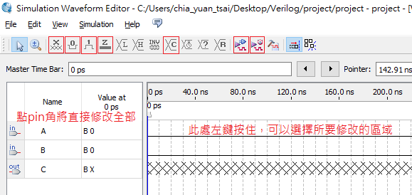
Waveform simulation
•Waveform simulation interface
•Set module Input
•Start simulation
Forcing unkow
Forcing 0
Forcing 1
High impendance
counter
clock
Functional simulation
Timing simulation

Slide 16
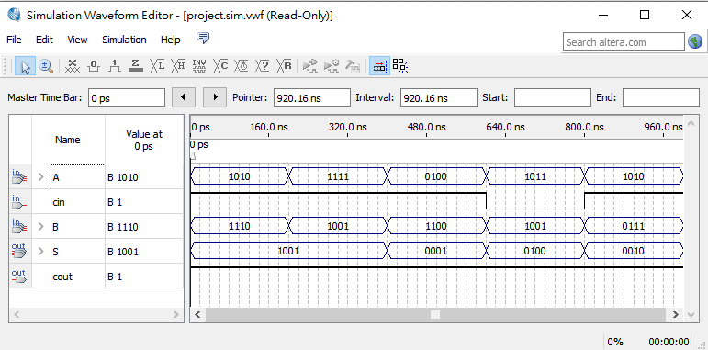
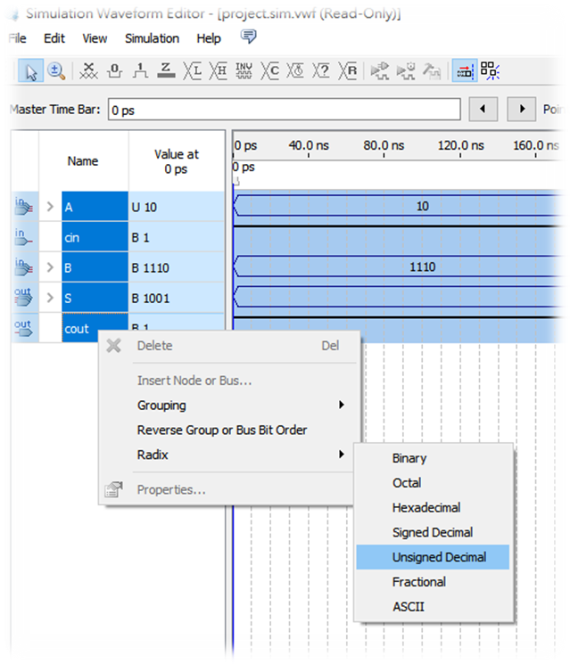
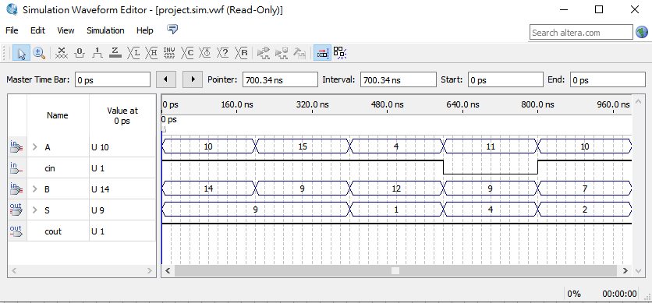
Waveform simulation
Use waveform simulation comfirm the results.
Changin radix for easier result observation.

Slide 17
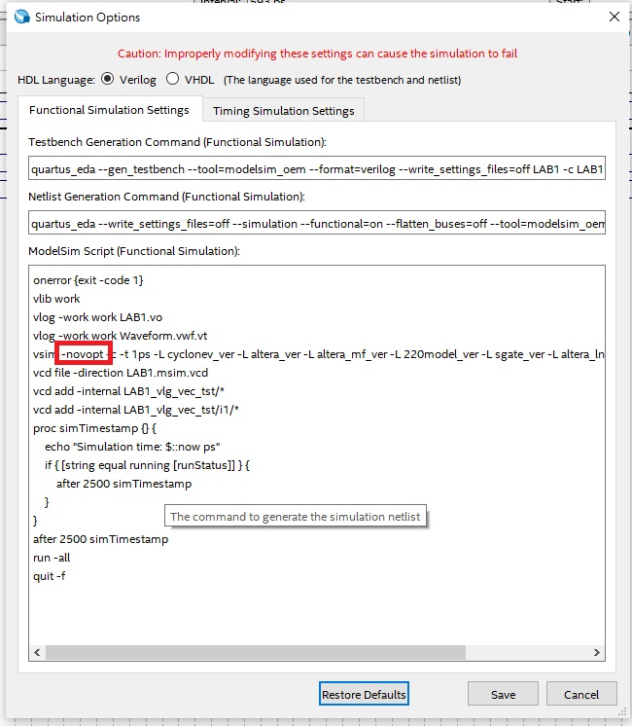
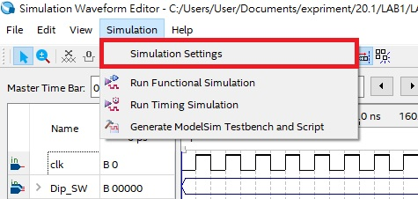
Simulation error
** Error (suppressible): (vsim-12110) All optimizations are disabled because the -novopt option is in effect.
Error message
This is because a feature of the simulation program has been
discontinued, but it has not been removed in this version yet.
Solution:
Simulation->Simulation Settings
Delete "–novopt" and save .

Slide 18
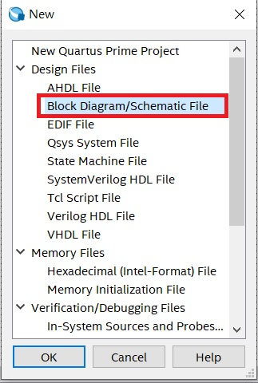
Block diagram
[File]-> New -> Block Diagram / Schematic File.

Slide 19
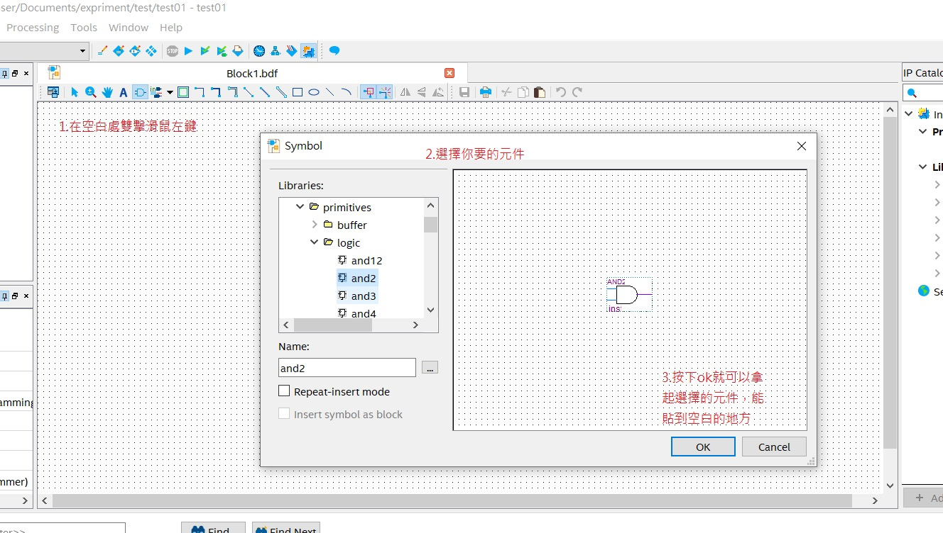
Block diagram
Add symbol: Double-clicks on Block Diagram empty space, choose symbol and press OK.
1.Double-Click
2.Choose component
3.click "ok" to pick up the selected component

Slide 20
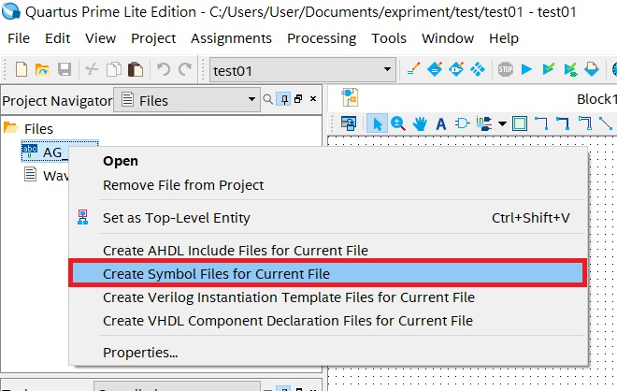
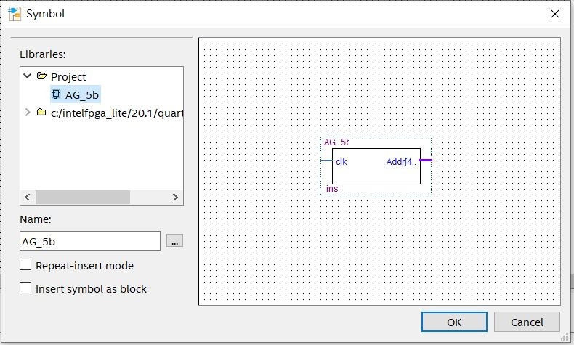
Block diagram
Generate symbol
Right click module after the compile is sucessful, choose”Create Symbol Files for Current File”.
And you can find it in the Project file.

Slide 21
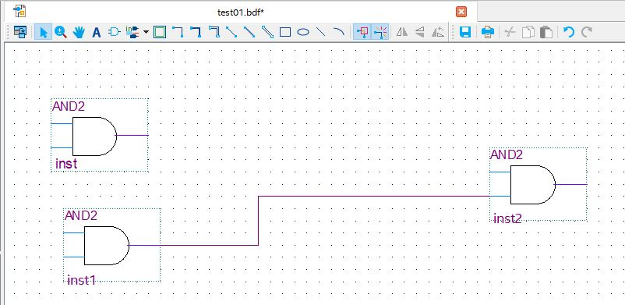
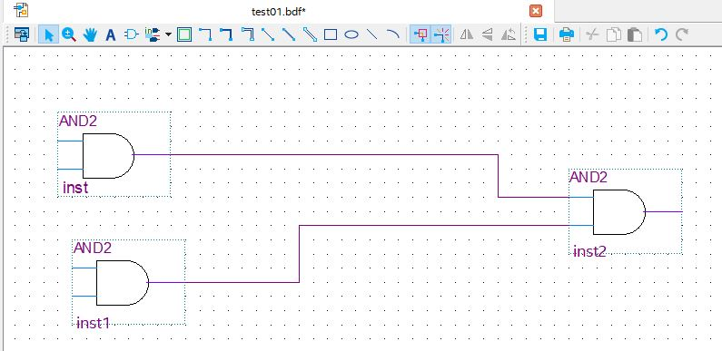
Block diagram
Wiring: Create port to every component. EX: We use the tool inside the blue box connect inst1 and inst2.

Slide 22
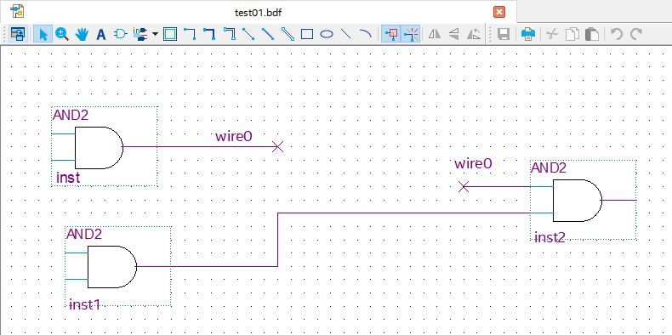
Block diagram
Name: Click wire and name. The lines on the diagram dosen't need to be connected, it make the diagram more clean.

Slide 23

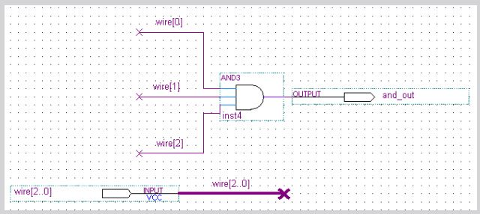
Block diagram
BUS: Use a single bold line represent multiple ports, we call "Bus". The format is： Name[MSB.. LSB]，EX: wire[2..0].
The wire connected INPUT port is a multi-pin port, so the name as same as it. if we need a single port from the Bus, the naming format is: Name[bit number]. EX: wire[0], wire[1], wire[2].

Slide 24
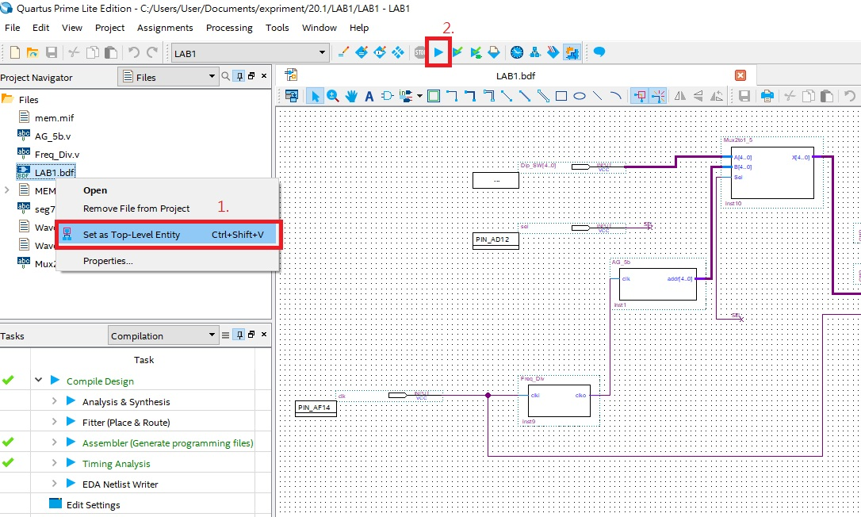
Block diagram
After wiring, set the ".bdf" file as top-level.
Complile, ckeck the whole circuit is correct.

Slide 25
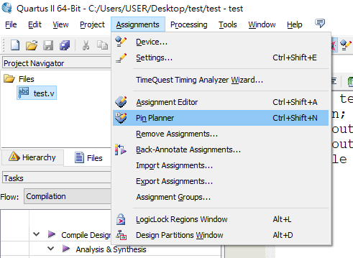
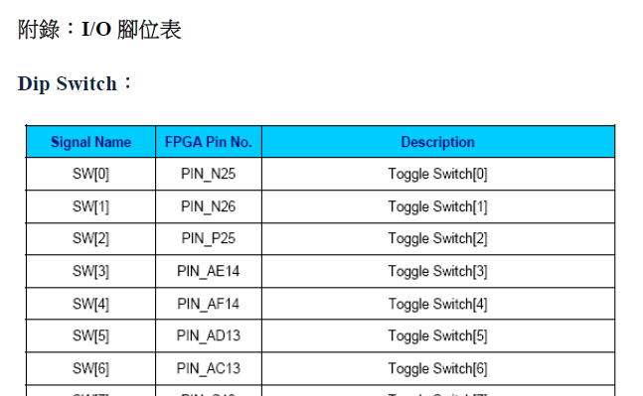
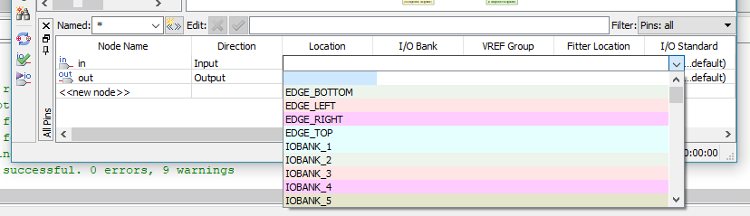
Layout
Pin Planner set：commonly used features are: Dip Switch、Push Button、LED、7_Segment、Clock.
Also have some output pin.
Setting circuit pin location that corresponding
the device. Like dip switch, LED...

Slide 26
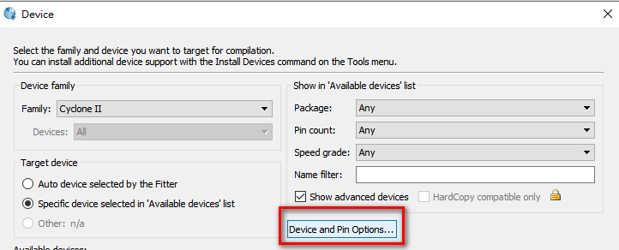
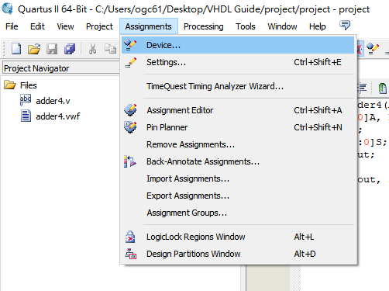
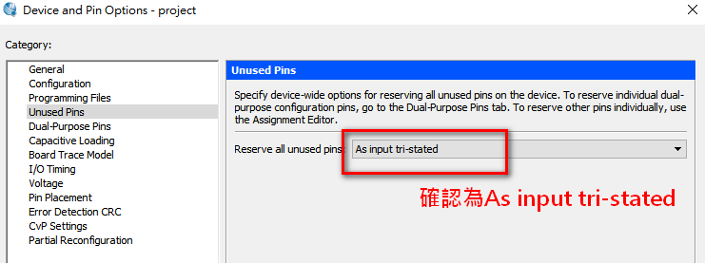
Layout
Setting the FPGA unsued pin.
Click "Device" → choose "Device and Pin Options…".
Click "Unused Pins" → make sure the option is「As input tri-stated」.
After setting pin and unused pins,
remember compile project again.
Make sure is "As input tri-stated"!!!

Slide 27
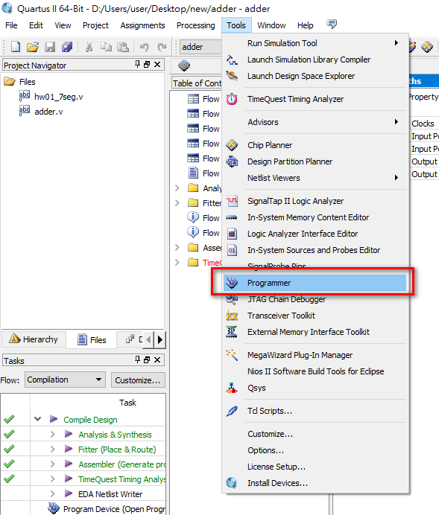

Layout
•Method 2
Programming the FPGA board with VHDL code
Method 1

Slide 28



LAYOUT
Click Hardware Setup
Choose DE-SoC
※:remember connect USB
Need intall driver if computer dosen't detect the device.
https://blog.csdn.net/qq_43546203/article/details/116999810
1.
2.
3.
4. Make sure device is "DE-Soc".

Slide 29


LAYOUT
Click Auto Detect
Choose 5CSEMA5

Slide 30


LAYOUT
Detect FPGA and HPS
Right click Device:”5CSEMA5”->
Choose Change File

Slide 31


LAYOUT
Choose " *.sof " file.
Tick "Programe/Configureand" and press start
2.
1.

Slide 32

FPGA introduction
Type: Cyclone V 5CSEMA5F31C6

Slide 33

LED：1 for light on, 0 for light off.
Switch：1 for on 0 for down.
7-Segment Display：0 for light on, 1 for light off.
Push button : push for 0, release for 1.
downloal USB
Power connector
Power

Slide 34

THE END

